Slide 1

Group 7 Library Application
Hoang tin Nguyen – 618682
Osama Quttriyeh – 617575
Jeffrey metz - 111435

Slide 2
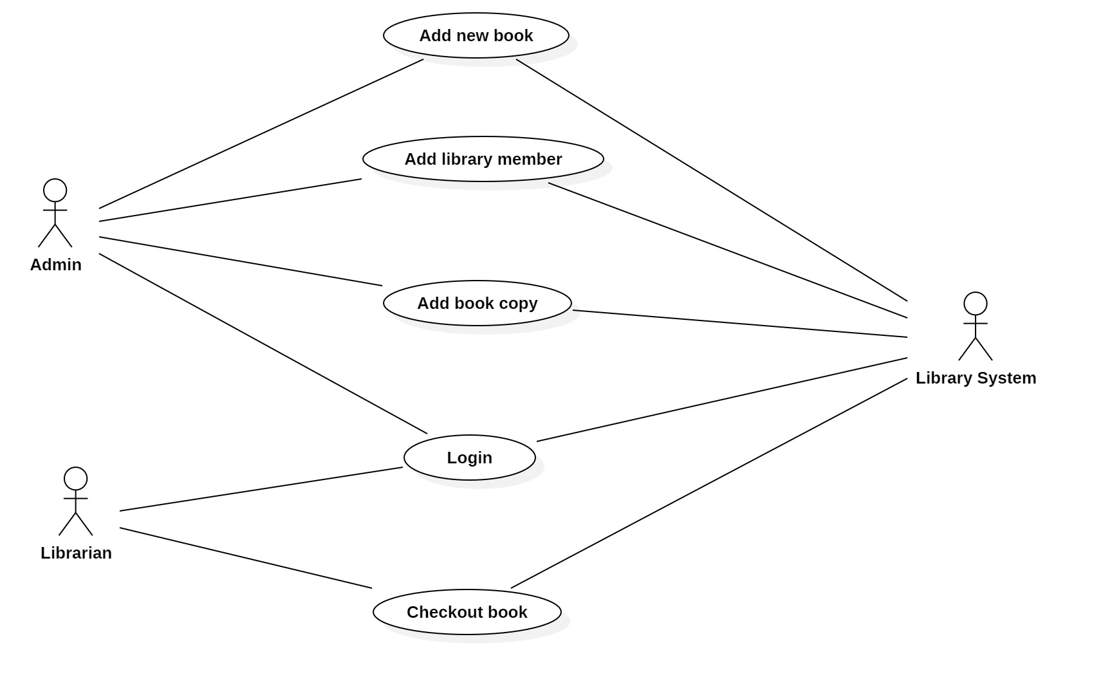
Use case diagram

Slide 3
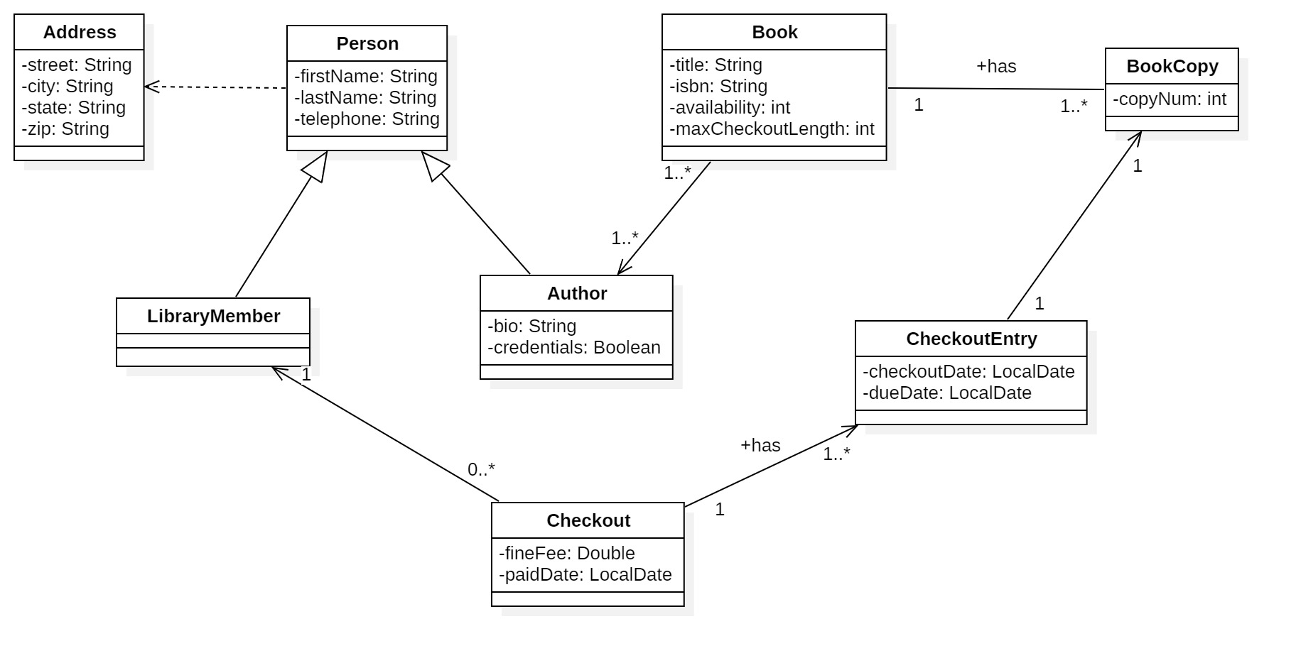
Class diagram

Slide 4
Class diagram – New member

Slide 5
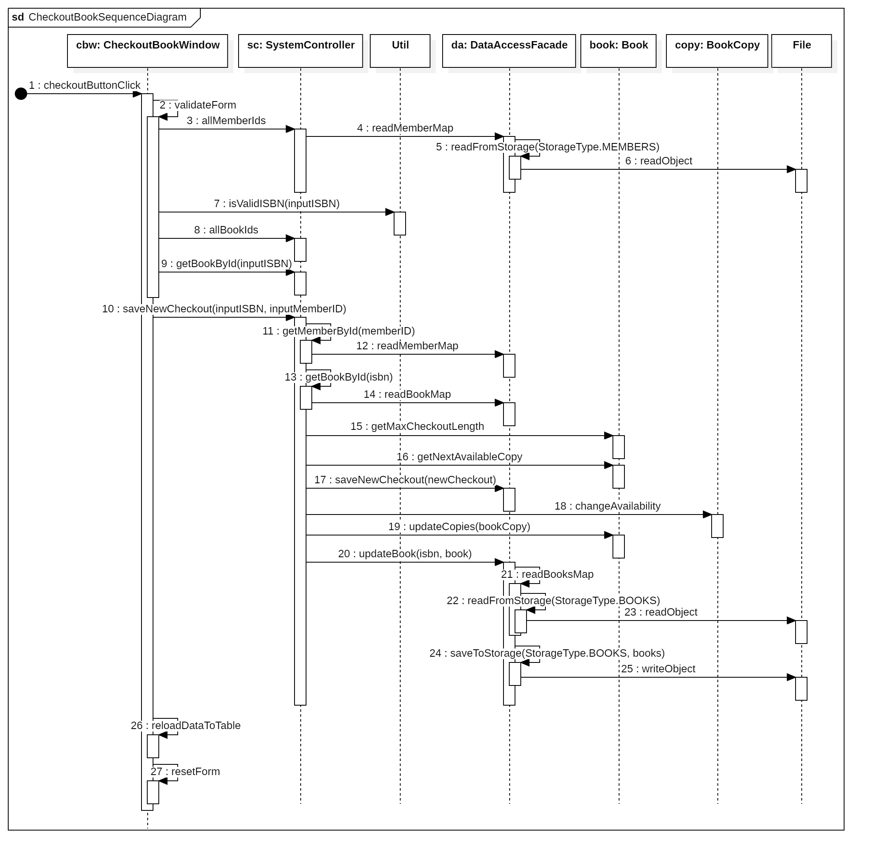
Sequence diagram 1 – Checkout book

Slide 6
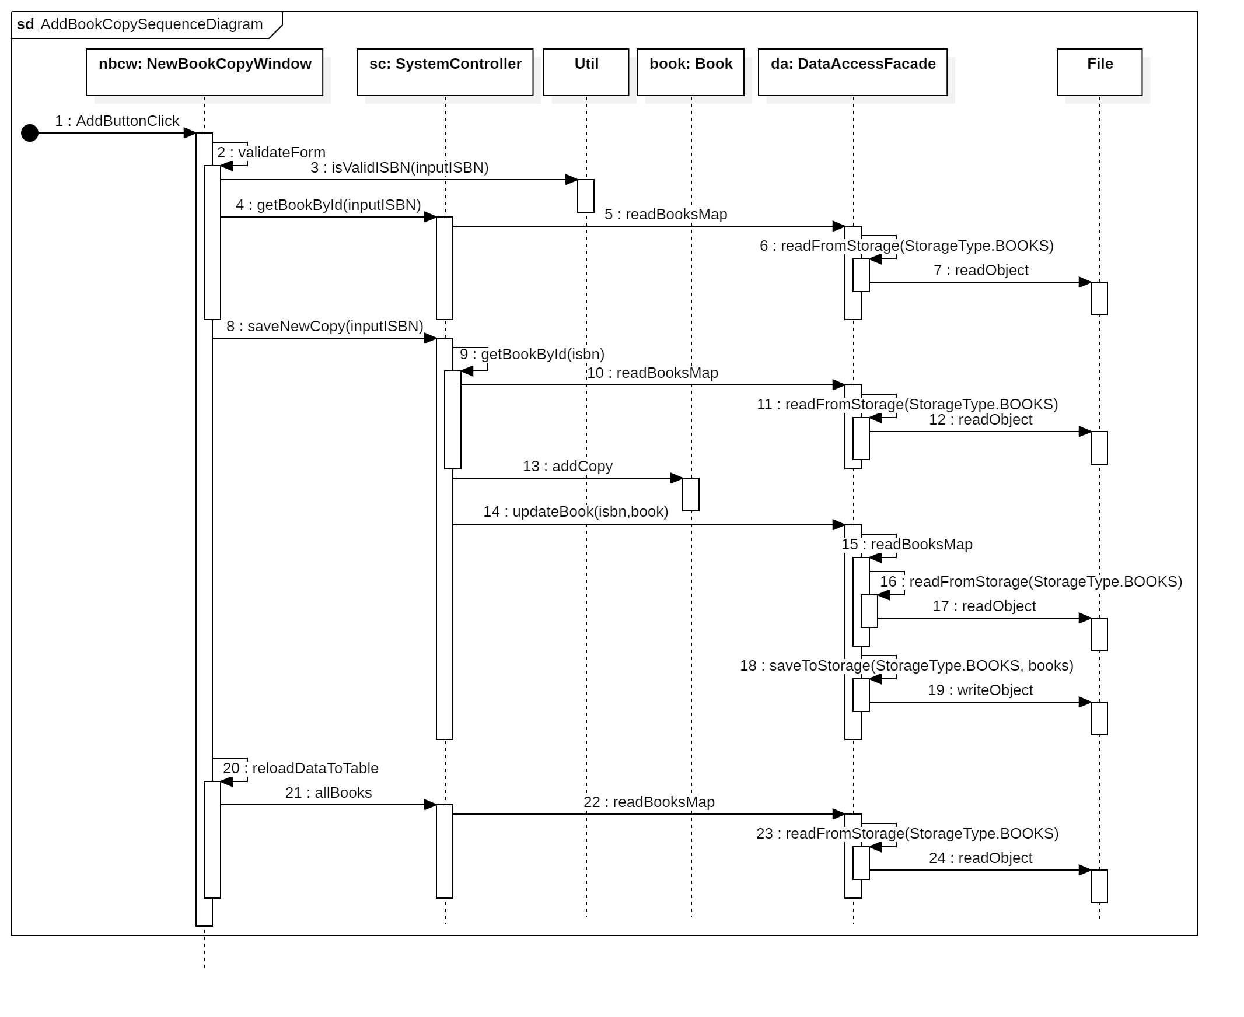
Sequence diagram 2 – Add book copy

Slide 7
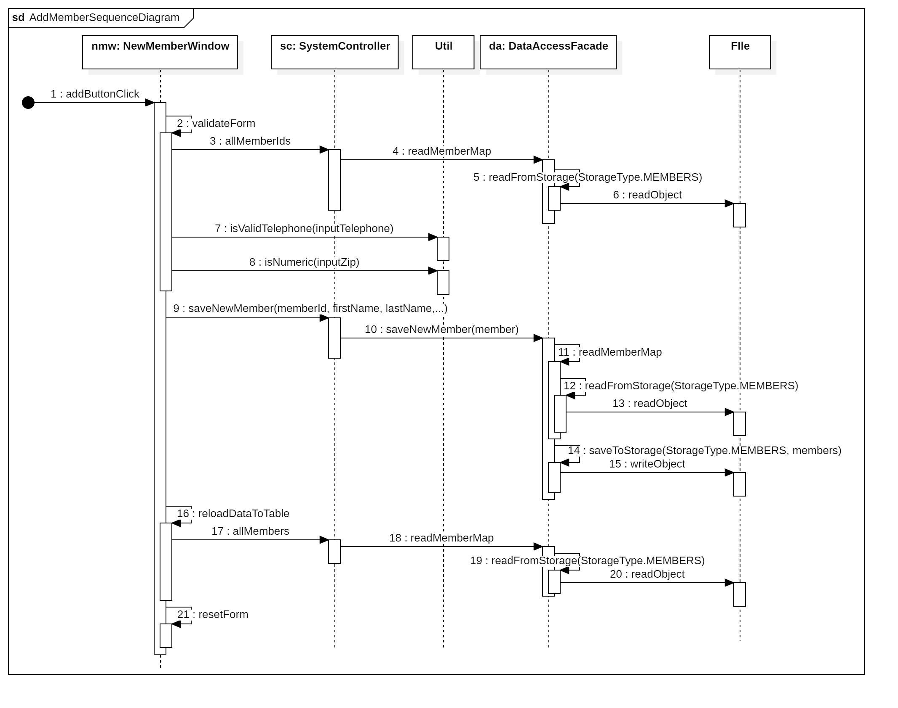
Sequence diagram 3 – Add member

Slide 8
Validation rules – Login form
Username is required
Password is required

Slide 9
Validation rules – New book form
Book title is required
Book isbn is required and valid “\d{2}-\d{5}”
Book isbn is not existed
Max checkout length is required and numeric
Max checkout length is in range [1,21]
Author is required at least one

Slide 10
Validation rules – New member form
Member Id is required and not existed
First name and last name are required
Telephone is required and valid “\d{3}-\d{3}-\d{4}”
Street, city, and state are required
Zip is required and numeric

Slide 11
Validation rules – New copy form
Book isbn is required and valid “\d{2}-\d{5}”
Book isbn must be existed

Slide 12
Validation rules – Checkout form
Member id is required and existed
Book isbn is required and valid “\d{2}-\d{5}”
Book isbn is existed and available to checkout (has a copy is available)

Slide 13
SCI conclusion

Slide 14
Demo
JDK 22
IDE: IntelliJ
https://github.com/venturousman/miu-mpp-library
Branch: master

Slide 15

Thanks for listening
This Photo by Unknown Author is licensed under CC BY-SA

Slide 16

Q&A
This Photo by Unknown Author is licensed under CC BY-NC

